Slide 1
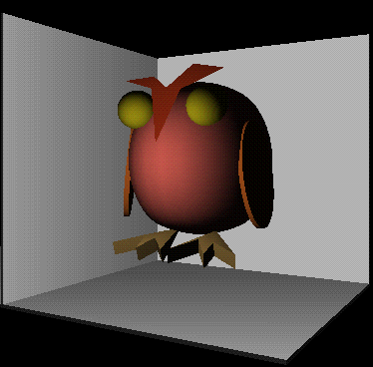
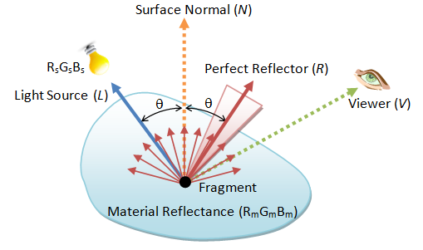
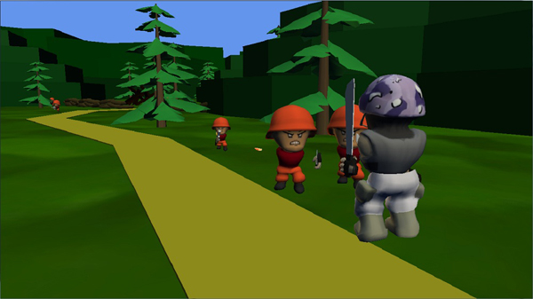
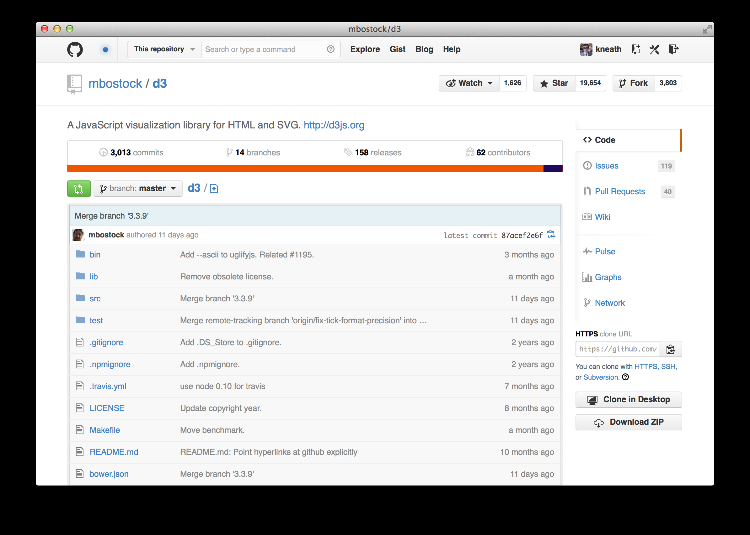
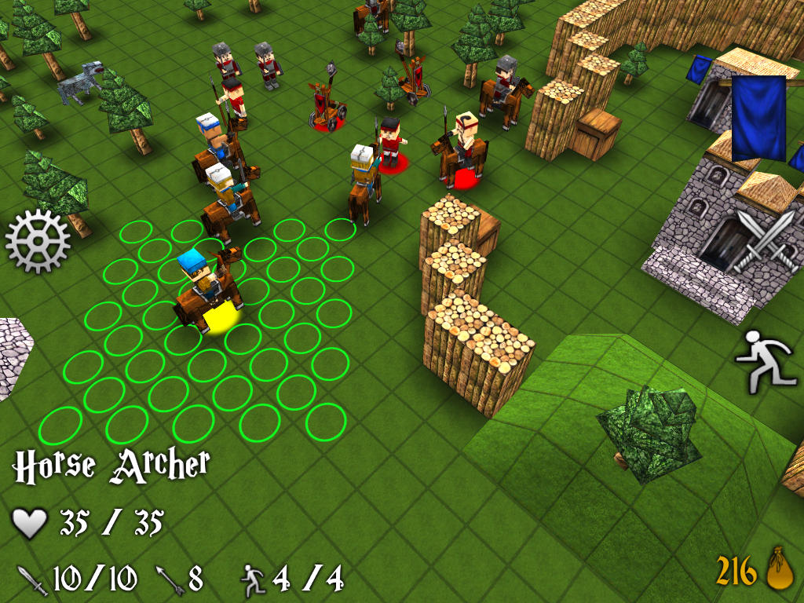
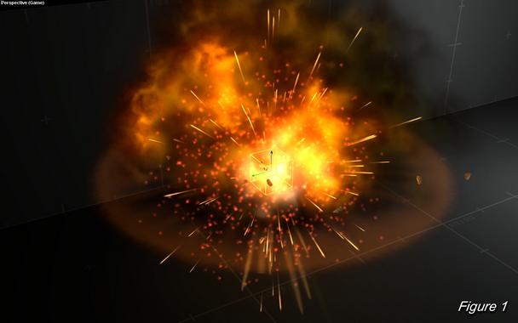
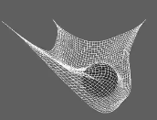
Vertex Buffers & Shaders
Advanced Games Programming (CGP600)

Slide 2
Overview
Geometry (Triangles)
Shaders
Vertex
Pixel
Examples
Lighting
Anti-Aliasing
Bloom

Slide 3
3-Dimensional Objects

Slide 4
Rendering 3D Objects
EVERY 3D engine renders objects as a collection of triangles.
Each triangle defined by three points in world space
Triangles can share points.

Slide 5
Rendering 3D Objects
1 Cube
8 Vertices
12 Triangles

Slide 6
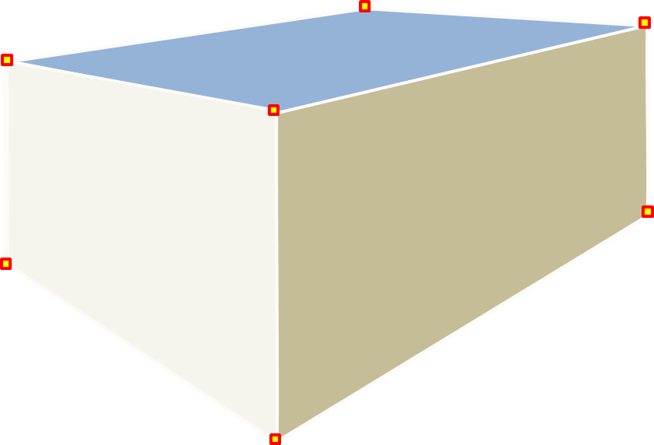
But what about Quads?

Slide 7
But what about Quads?
Preferred medium for artists and animators

Slide 8
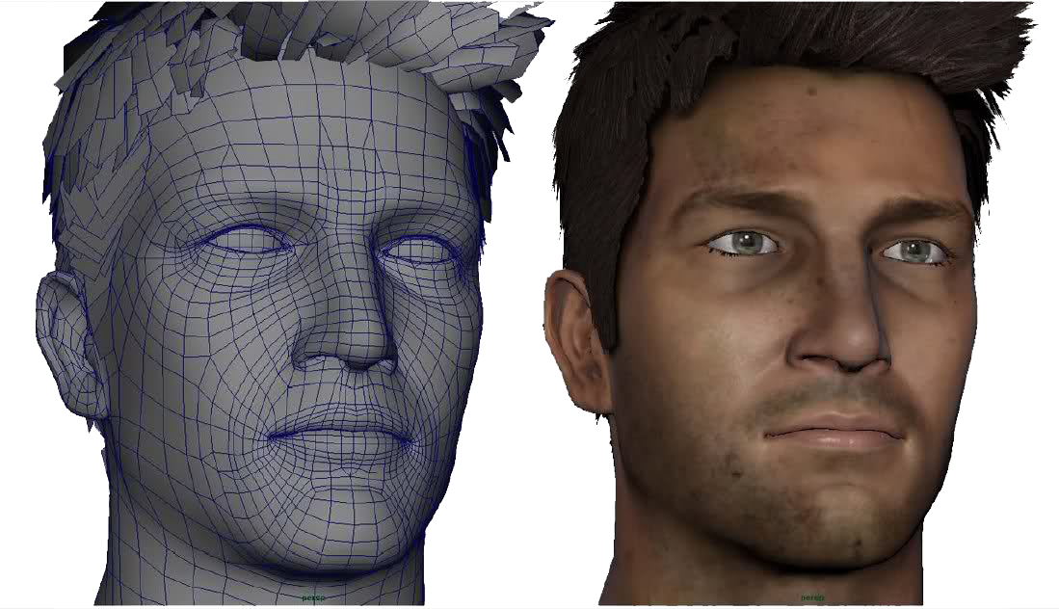
Why bother with Quads?

Slide 9
But what about Quads?
Uncluttered meshes – easier to work with
Easy to deform without creating artefacts (unexpected folds) – great for animation.
Therefore, easier to generate organic-looking models.

Slide 10
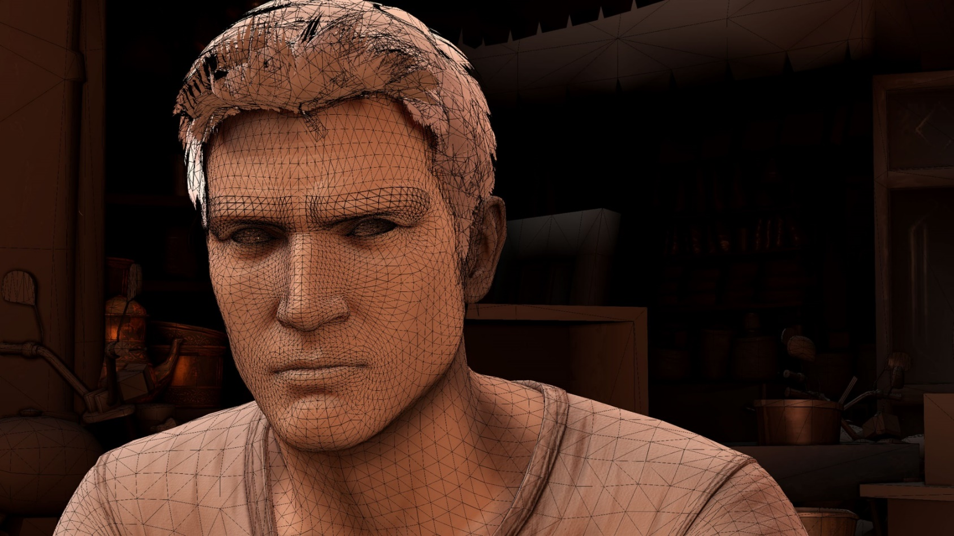
But what about Quads?
However, NO 3D rendering engine (even 3DSMax or Maya) renders in quads.
They ALL render in triangles
They SHOW quads to make the artist’s life easier

Slide 11
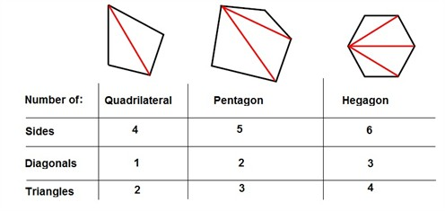
So why Triangles?
Most basic – and therefore simplest 3D primitive
ALL primitive shapes can be made from triangles (including triangles themselves)

Slide 12
So why Triangles?
A triangle will ALWAYS define a flat plane - very useful for calculating:
Lighting
Intersection (e.g. collision)
Back Face Culling

Slide 13
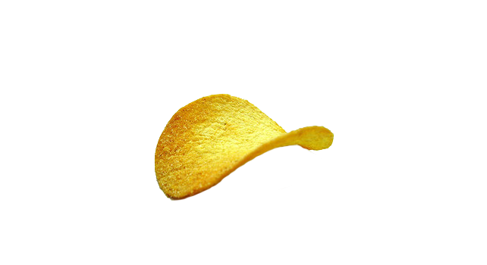
So why Triangles?
Quads, pentagons and
n-gons will not necessarily define a flat plane
This quad introduces the need for additional steps to calculate:
Lighting
Intersection (e.g. collision)
Back Face Culling
All 4 points of quad not on same plane

Slide 14
So why Triangles?
TRIANGLES!
Simple & consistent
Calculations can therefore be heavily optimised
All 3D engines use triangles to make life simple and fast

Slide 15
Displaying 3D Objects
Vertex data
Contains:
pos (x,y,z)
normal vector
colour
texture coords
(multiple)
Extra stuff e.g.:
fog coords

Slide 16
Vertex List
A list of vertices used to define a shape
struct VERTEX
{
XMFLOAT3 Pos;
XMFLOAT4 Col;
}
Vertex 3
Vertex 2
VERTEX vertices[] =
{
vertex1,
vertex2,
vertex3
};
Vertex 1

Slide 17
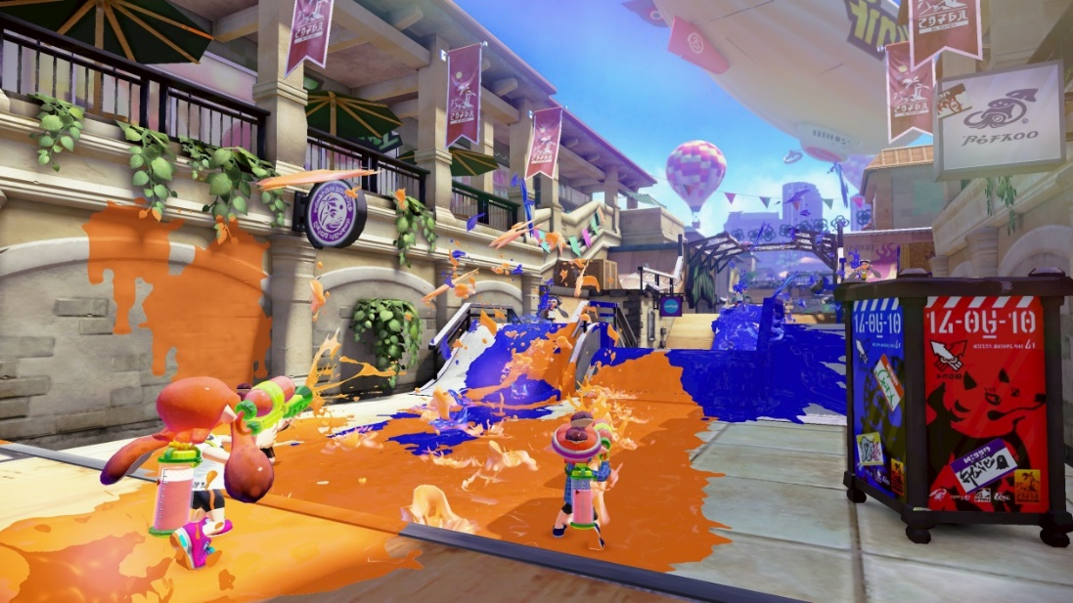
Vertex Buffer
Optimised resource that accepts a vertex list and pipes it to graphics hardware
Vertex Buffer
Graphics Hardware
Vertex
List
Processed Vertices
Geometry Processing
Pixel Processing
Pixel Rendering

Slide 18
Shaders
A shader: A specialised program used to draw something in a particular way.
Different APIs have their own shader ‘language’
OpenGL: GLSL (GL Shader language)
DirectX: HLSL (High Level Shader language)
Vulkan: SPIR-V (This language is extremely low level)

Slide 19
Shaders
A shader: A specialised program used to draw something in a particular way.
Different types:
Vertex shaders
Pixel (or Fragment) shaders
Geometry shaders
Tesselation shaders

Slide 20
Shaders
A shader: A specialised program used to draw something in a particular way.
Vertex Shader
Used For:
Processes vertex data (can’t add new vertices)
Shader program runs once on EVERY vertex
Takes vertex data, manipulates it and outputs modified vertex data

Slide 21
Shaders
A shader: A specialised program used to draw something in a particular way.
Vertex Shader
Example usage:
Converting 3D space co-ordinates to 2D screen co-ordinates.
Using vert data for lighting effects (reflection, refraction, etc)
Texturing

Slide 22
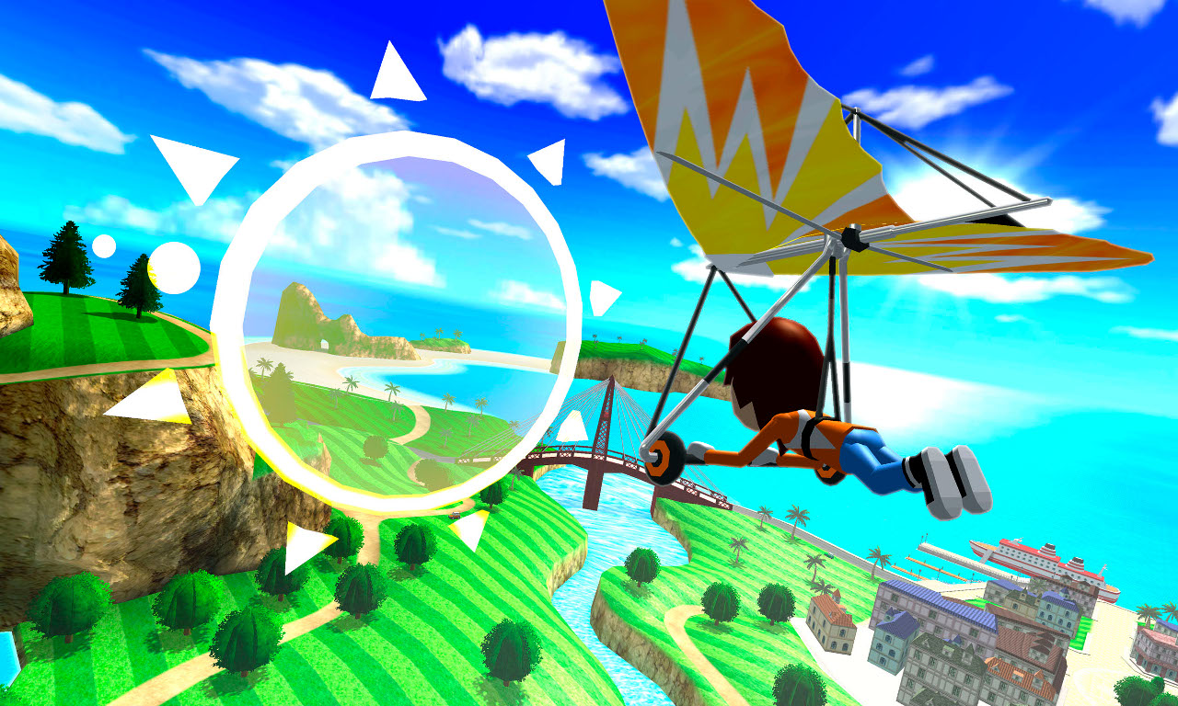
Shaders
A shader: A specialised program used to draw something in a particular way.
3D Rendering (perspective) – vertex shader

Slide 23
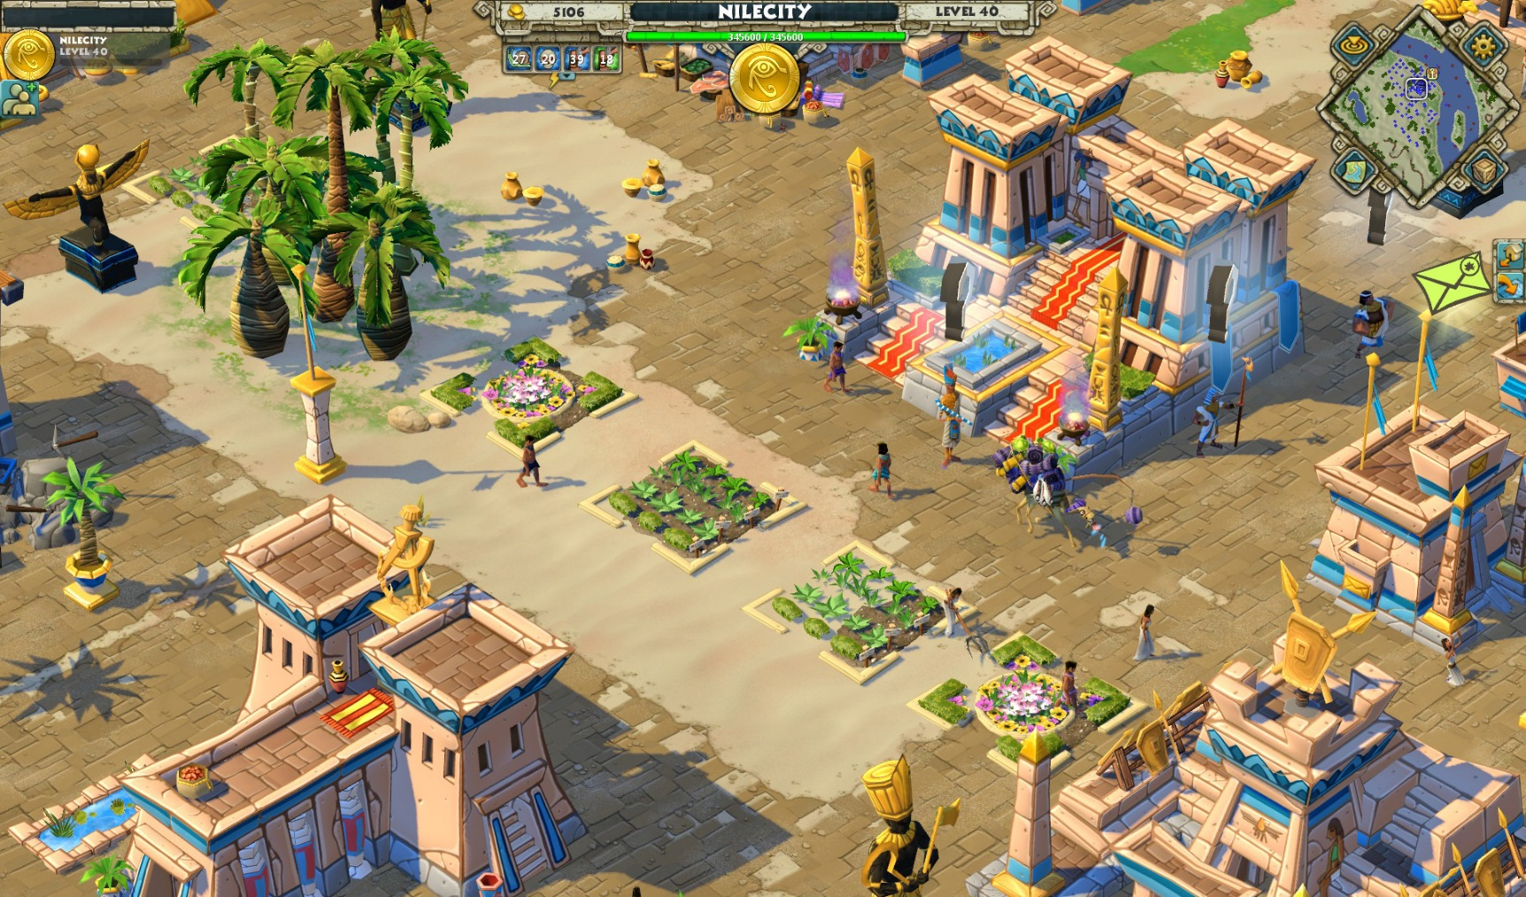
Shaders
A shader: A specialised program used to draw something in a particular way.
3D Rendering (orthographic) – vertex shader

Slide 24
Shaders
A shader: A specialised program used to draw something in a particular way.
Pixel Shader
Used For:
Processing screen pixels
Post-processing effects

Slide 25
Shaders
A shader: A specialised program used to draw something in a particular way.
Pixel Shader
Example usage:
Smoothing and edge detection
lighting effects
Blur and bloom.

Slide 26
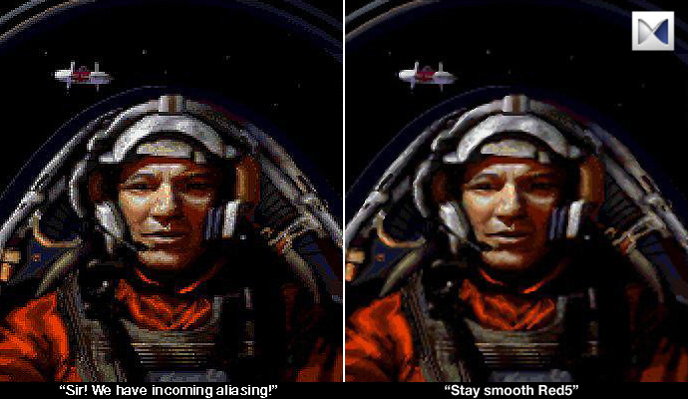
Shaders
A shader: A specialised program used to draw something in a particular way.
Antialiasing – pixel shader

Slide 27

Shaders
A shader: A specialised program used to draw something in a particular way.
Bump Mapping – pixel shader

Slide 28
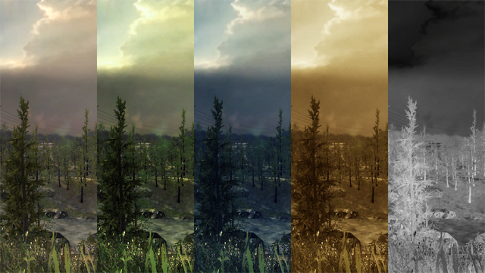
Shaders
A shader: A specialised program used to draw something in a particular way.
Colour Correction Look-Up Tables – pixel shader

Slide 29
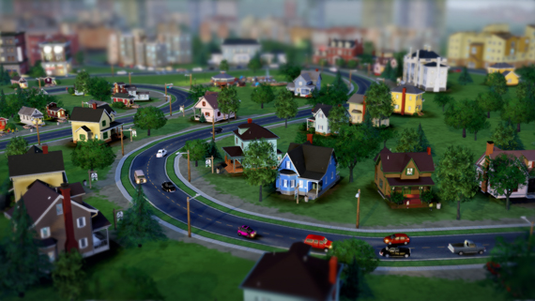
Shaders
A shader: A specialised program used to draw something in a particular way.
Tilt shift – pixel shader

Slide 30
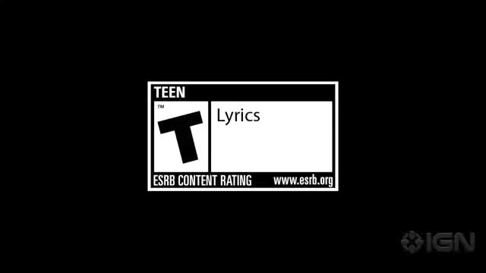
Shaders
A shader: A specialised program used to draw something in a particular way.

Slide 31
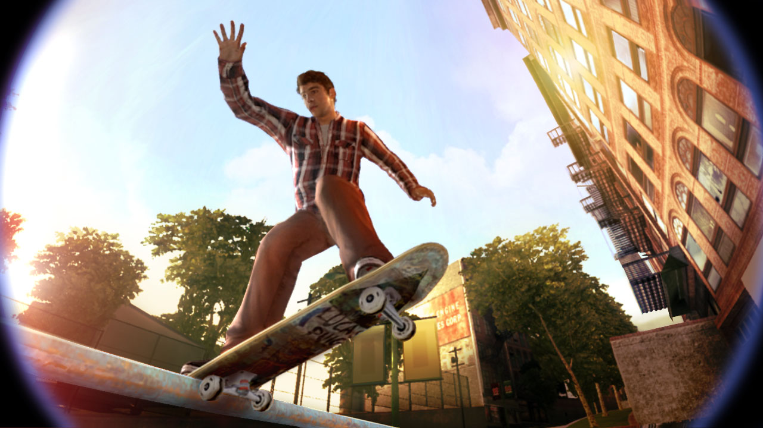
Shaders
A shader: A specialised program used to draw something in a particular way.
Fish eye – Vertex and / or pixel shader

Slide 32
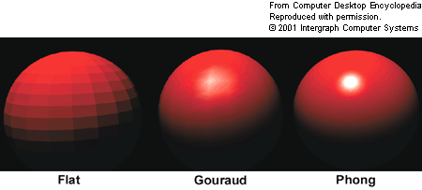
Shaders
A shader: A specialised program used to draw something in a particular way.
Lighting and Shadows – vertex and pixel shader

Slide 33
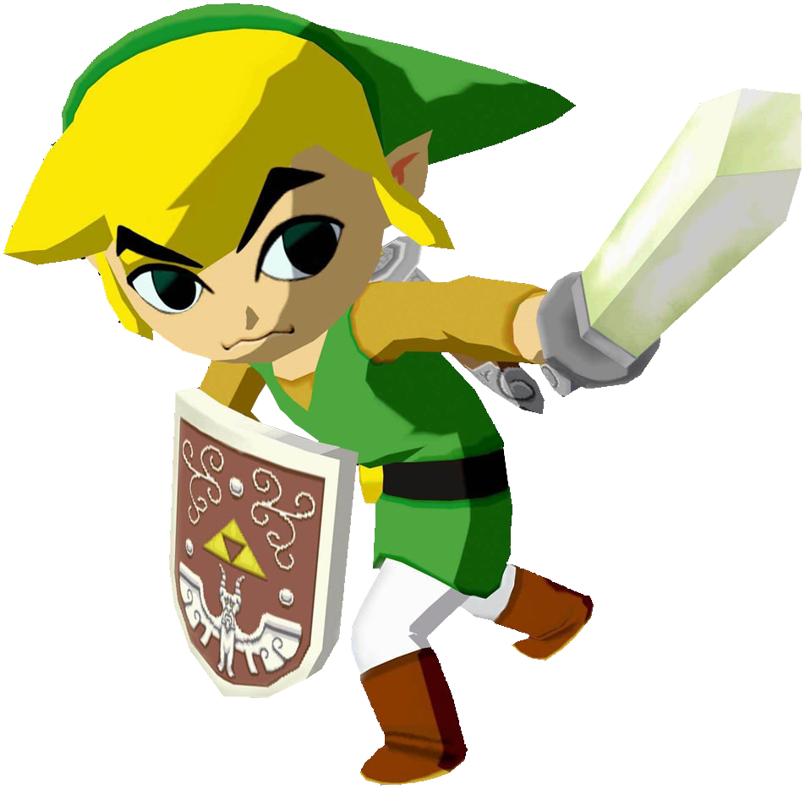
Shaders
A shader: A specialised program used to draw something in a particular way.
Game examples include:
Doctor Hauzer
Parappa the Rapper
Fear Effect
And Jet Set Radio
Cel Shading – vertex and pixel shaders

Slide 34
Shaders
A shader: A specialised program used to draw something in a particular way.
Geometry Shader (optional)
Creates new geometries on the fly, using vertex shader output as input.
Can add new vertices.
A single vertex can generate complex geometries.
Example usage:
Appropriate level-of-detail geometries generated at run-time – minimises wasted performance or too-low-res graphics.

Slide 35
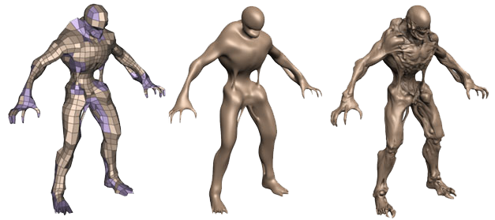
Shaders
A shader: A specialised program used to draw something in a particular way.
Tessellation Shader (optional)
Subdivision of vertex patches (split triangles into smaller triangles) at run time.
Example usage:
Real time smoothing.
Additional detail (used in conjunction with displacement maps) calculated at run-time.

Slide 36
Further reading
Primer: Shaders – UnderscoreDiscovery.com
http://notes.underscorediscovery.com/shaders-a-primer/
Shader Programming – Lighthouse3D.com
(uses GLSL, but the instructions can be adapted to DirectX11)
http://www.lighthouse3d.com/tutorials/glsl-tutorial/
Subdivision Surfaces: Artifacts – The Guerrilla CG Project
https://www.youtube.com/watch?v=k_S1INdEmdI
Geometry Shaders – open.gl
https://open.gl/geometry
DirectX 11 Tessellation – Nvidia
http://www.nvidia.com/object/tessellation.html
Tessellation Shaders Tutorial – OGLdev
http://ogldev.atspace.co.uk/www/tutorial30/tutorial30.html

Slide 37
Summary
Understand what and why we use Vertex Buffer and Shaders
Different type of shaders
(e.g., vertex and pixel shader)

Slide 38
To do this week…
Read over the lectures
Practicals
Challenging – hence, start early
Source control – (i.e., Github)
Work through tutorial practicals
Experiment (get into good habits)

